Slide 1

Predicting Default on Loan Payments
Team 40, Section B
Arwen Wang, Kewei Jiang, Kieu Anh Nguyen, Taru Dharra and Vedant Sahay

Slide 2

Agenda
Business Understanding
Description of data and harmonization
Exploratory Data Analysis
Segmentation through Clustering
Models and Cross Validation
Deployment and Business Insights

Slide 3
Business Understanding
Non Bank Financial Institution (NBFI) - lends primarily to people with zero/little credit history
As per Global Monitoring Report, the financial stability risk of NBFI grew by 8.5% to $51.6 trillion in 2017
Home Credit - NBFI - high risk of default by borrowers
Kaggle Dataset - Home Credit Risk Default
Core Task - Default Probability Estimation

Slide 4
Description of Data and Harmonization
Data and issues | Harmonization
Main dataset with target variable and test data set without target variable Multiple tables provided 122 variables 61 variables with missing values coded in various ways, many of which missing up to 40% of the values | Format main dataset and test Split main data into data and data.holdout 60:40 Remove outliers Remove variables missing more than 15% Remove small number of missing data Impute using classification tree and regression tree

Slide 5
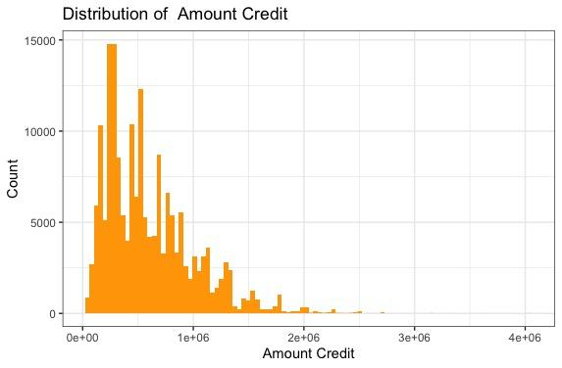
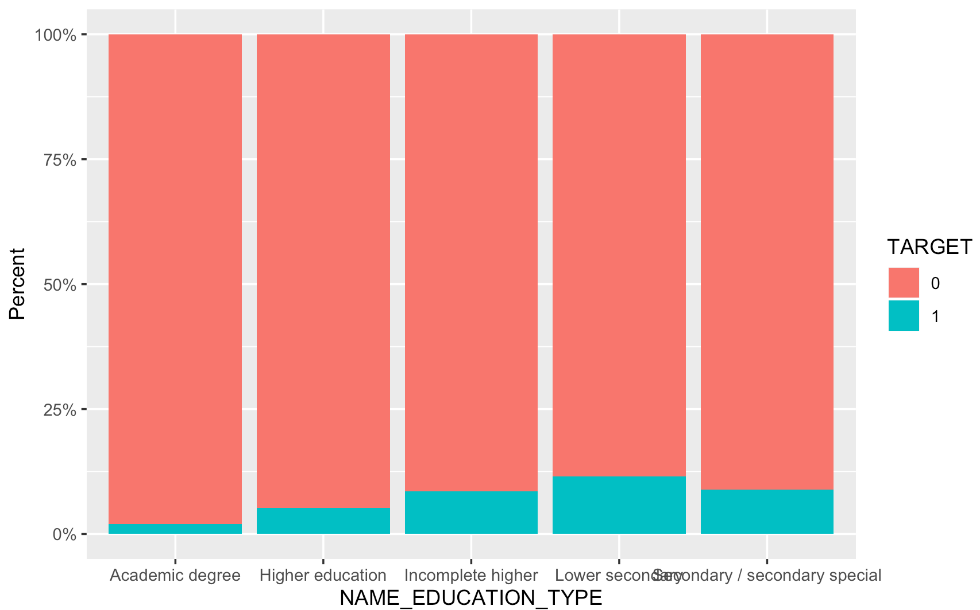
Exploratory Data Analysis

Slide 6
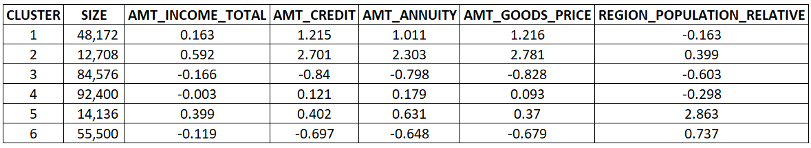
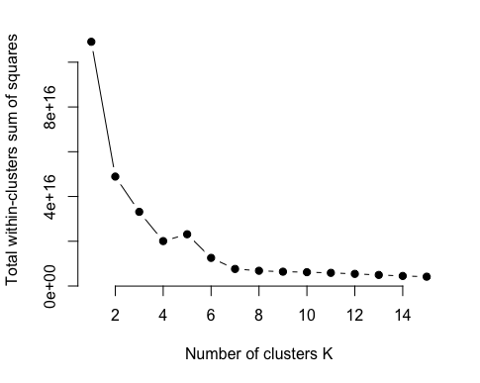
Segmentation through Clustering
Optimal # of clusters

Slide 7
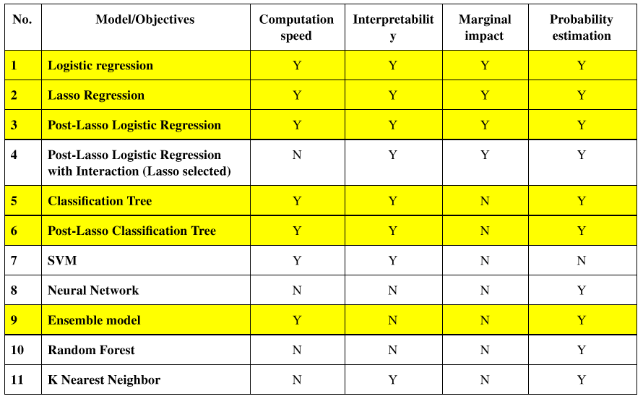
Models and it’s accuracy
Core Data Mining Task - Probability estimation for Classification
Y - Model meets Criteria
N - Model does not meet Criteria

Slide 8
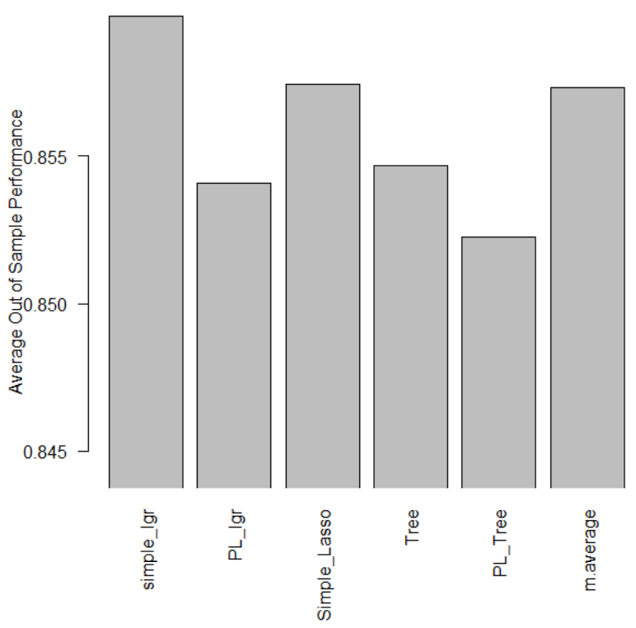
Models and it’s accuracy
Simple Logistic Regression is the best performing model.
The OOS accuracy is quite comparable between all the models indicating that the predictive power is quite comparable.

Slide 9
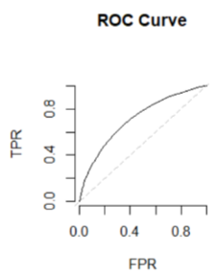
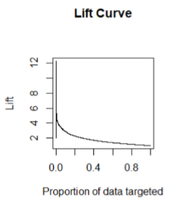
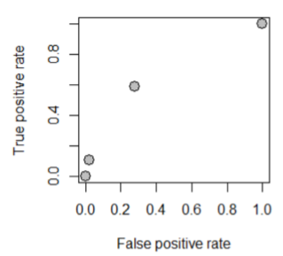
Models and it’s accuracy
0.1 Threshold

Slide 10

Deployment and Business Insights
Implement the model on up to 40% of the customer base to have a performance twice as well as random guessing
Test set result: 26% default at 10% threshold
Default risk increasing factors:
Male
Lower education
Applied for loan not in city of residence
Lives outside of the city he applied in
Young
Single
Fail to provide documents
Has people who default in his social circle

Slide 11


